Slide 1
Retrieval-Augmented Generation (RAG)
Retrieval-Augmented Generation (RAG) is a technique that enhances language model generation by incorporating external knowledge.
This is typically done by retrieving relevant information from a large corpus of documents and using that information to inform the generation process.

Slide 2
Challenge:
Clients often have vast proprietary documents.
Extracting specific information is like finding a needle in a haystack.

Slide 3
2. GPT4-Turbo Introduction:
OpenAI’s GPT4-Turbo can process large documents.

Slide 4
3. Efficiency Issue:
“Lost In The Middle” phenomenon hampers efficiency.
Model forgets content in the middle of its contextual window.

Slide 5
4. Alternative Approach — RAG
Create an index for each document paragraph.
Swiftly identify pertinent paragraphs.
Feed selected paragraphs into a Large Language Model (LLM) like GPT4.

Slide 6
5. Advantages
Prevents information overload.
Enhances result quality by providing only relevant paragraphs.

Slide 7
RAG Paper
In a 2020 paper, Meta (then known as Facebook) came up with a framework called retrieval-augmented generation to give LLMs access to information beyond their training data. RAG allows LLMs to build on a specialized body of knowledge to answer questions in more accurate way.
https://arxiv.org/abs/2005.11401v4
“It’s the difference between an open-book and a closed-book exam,” Lastras said. “In a RAG system, you are asking the model to respond to a question by browsing through the content in a book, as opposed to trying to remember facts from memory.”

Slide 8
As the name suggests, RAG has two phases: retrieval and content generation.
In the retrieval phase, algorithms search for and retrieve snippets of information relevant to the user’s prompt or question.
In an open-domain, consumer setting, those facts can come from indexed documents on the internet;
in a closed-domain, enterprise setting, a narrower set of sources are typically used for added security and reliability.
This assortment of external knowledge is appended to the user’s prompt and passed to the language model.
In the generative phase, the LLM draws from the augmented prompt and its internal representation of its training data to synthesize an engaging answer tailored to the user in that instant.
The answer can then be passed to a chatbot with links to its sources.

Slide 9
The Retrieval Augmented Generation (RAG) Pipeline
With RAG, the LLM is able to leverage knowledge and information that is not necessarily in its weights by providing it access to external knowledge sources such as databases.
It leverages a retriever to find relevant contexts to condition the LLM, in this way, RAG is able to augment the knowledge-base of an LLM with relevant documents.

Slide 10
The retriever here could be any of the following depending on the need for semantic retrieval or not:
Vector database:
Typically, queries are embedded using models like BERT for generating dense vector embeddings.
Alternatively, traditional methods like TF-IDF can be used for sparse embeddings.
The search is then conducted based on term frequency or semantic similarity.
Graph database:
Constructs a knowledge base from extracted entity relationships within the text.
This approach is precise but may require exact query matching, which could be restrictive in some applications.
Regular SQL database:
Offers structured data storage and retrieval but might lack the semantic flexibility of vector databases.

Slide 11
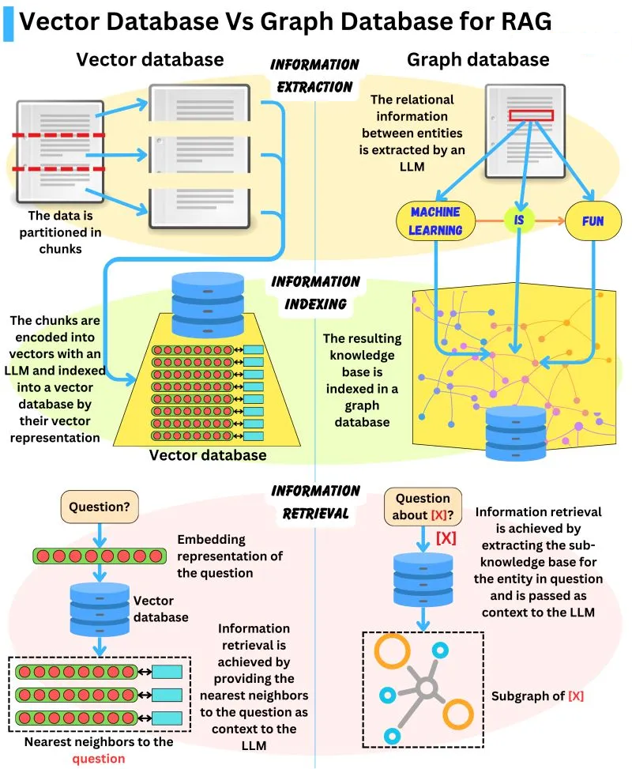

Slide 12
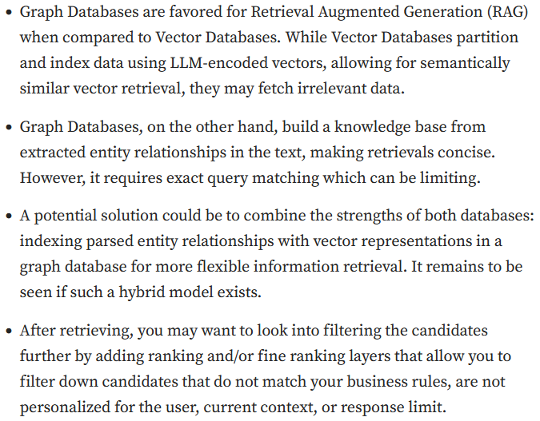

Slide 13
The process of RAG
Vector Database Creation:
RAG starts by converting an internal dataset into vectors and storing them in a vector database (or a database of your choosing).
User Input:
A user provides a query in natural language, seeking an answer or completion
Information Retrieval: The retrieval mechanism scans the vector database to identify segments that are semantically similar to the user’s query (which is also embedded).
These segments are then given to the LLM to enrich its context for generating responses.
Combining Data: The chosen data segments from the database are combined with the user’s initial query, creating an expanded prompt.
Generating Text: The enlarged prompt, filled with added context, is then given to the LLM, which crafts the final, context-aware response.

Slide 14
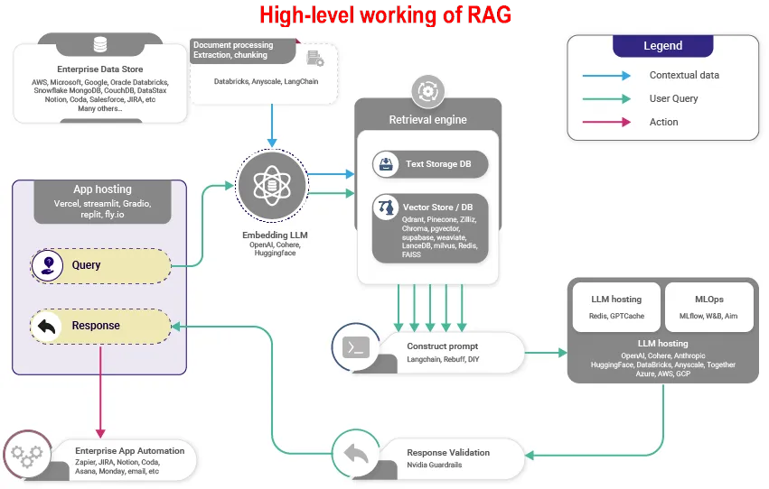

Slide 15
Difference Between RAG and Fine Tuning of the LLM:
Retrieval systems (RAG) give LLM systems access to factual, access-controlled, timely information.
Fine tuning can not do this, so there’s no competition.
Fine tuning (not RAG) adapts the style, tone, and vocabulary of LLMs
so that your linguistic “paint brush” matches the desired domain and style
All in all, focus on RAG first. A successful LLM application must connect specialized data to the LLM workflow.
Once you have a first full application working, you can add fine tuning to improve the style and vocabulary of the system.
Fine tuning won’t save you if the RAG connection to data is built improperly.

Slide 16
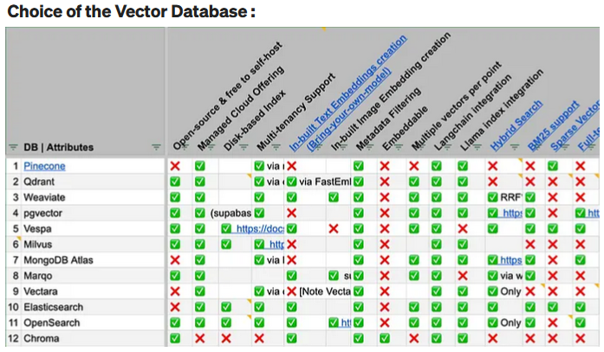

Slide 17
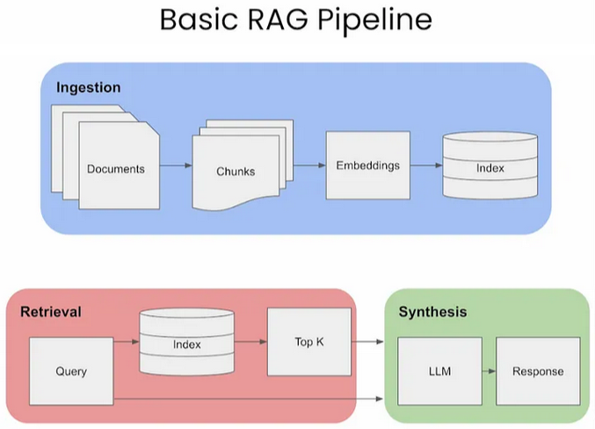

Slide 18
we will go over these key areas.
Ingestion
Retrievel
Synthesis

Slide 19
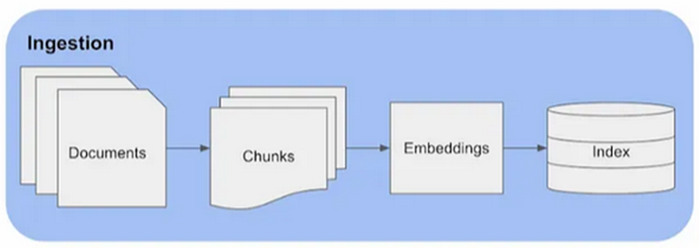
1. INGESTION

Slide 20
1. Chunking
Chunking is the process of dividing the prompts and/or the documents to be retrieved, into smaller, manageable segments or chunks.
These chunks can be defined either by a fixed size, such as a specific number of characters, sentences or paragraphs.
In RAG, each chunk is encoded into an embedding vector for retrieval.
Smaller, more precise chunks lead to a finer match between the user’s query and the content, enhancing the accuracy and relevance of the information retrieved.
Larger chunks might include irrelevant information, introducing noise and potentially reducing the retrieval accuracy.
By controlling the chunk size, RAG can maintain a balance between comprehensiveness and precision.

Slide 21
Chunk Size
So, the next natural question that comes up is, how do you choose the right chunk size for your use case?
The choice of chunk size in RAG is crucial.
It needs to be small enough to ensure relevance and reduce noise but large enough to maintain the context’s integrity.

Slide 22
Let’s look at a few methods:
Fixed-size chunking:
Simply decide the number of tokens in our chunk along with whether there should be overlap between them or not.
Overlap between chunks guarantees there to be minimal semantic context loss between chunks.
This option is computationally cheap and simple to implement.
Context-aware chunking:
Content-aware chunking leverages the intrinsic structure of the text to create chunks that are more meaningful and contextually relevant.
Naive Splitting:
A basic method where sentences are split using periods and new lines.
NLTK (Natural Language Toolkit):
A comprehensive Python library for language processing.
NLTK includes a sentence tokenizer that effectively splits text into sentences.
spaCy:
Advanced Python library for NLP tasks, it offers efficient sentence segmentation.

Slide 23
2. Embeddings
Once you have your prompt chunked appropriately, the next step is to embed it.
Embedding prompts and documents in RAG involves transforming both the user’s query (prompt) and the documents in the knowledge base into a format that can be effectively compared for relevance.
This process is critical for RAG’s ability to retrieve the most relevant information from its knowledge base in response to a user query.

Slide 24
Benchmark for Embeddings
One option to help pick which embedding model would be best suited for your task is to look at HuggingFace’s Massive Text Embedding Benchmark (MTEB) leaderboard.
https://huggingface.co/spaces/mteb/leaderboard

Slide 25
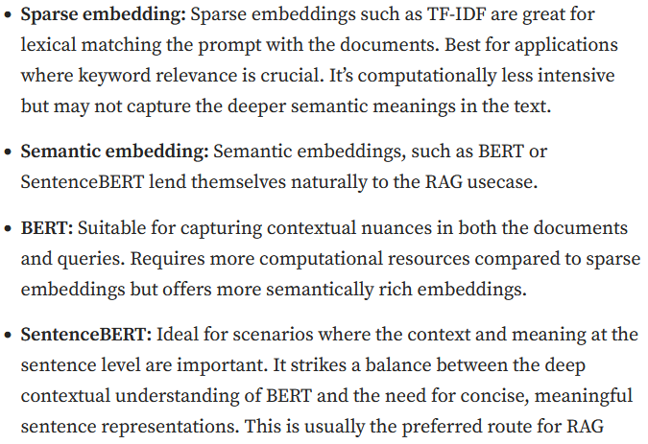
whether a dense or sparse embedding can be used

Slide 26
3. Retrieval
Let’s look at two different types of retrieval:
Standard/Naive Approach
Sentence-Window Retrieval
Each of these approaches has specific strengths and weaknesses.
Their suitability depends on the requirements of the RAG task, including the nature of the dataset, the complexity of the queries, and the desired balance between specificity and contextual understanding in the responses.

Slide 27
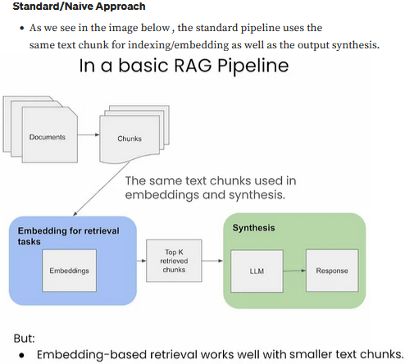

Slide 28
Advantages
Simplicity and Efficiency:
This method is straightforward and efficient, using the same text chunk for both embedding and synthesis, simplifying the retrieval process.
Uniformity in Data Handling:
It maintains consistency in the data used across both retrieval and synthesis phases.

Slide 29
Disadvantages
Limited Contextual Understanding:
LLMs may require a larger window for synthesis to generate better responses, which this approach may not adequately provide.
Potential for Suboptimal Responses:
Due to the limited context, the LLM might not have enough information to generate the most relevant and accurate responses.

Slide 30
Sentence-Window Retrieval / Small-to-Large Chunking
The sentence-window approach breaks down documents into smaller units, such as sentences or small groups of sentences.
It decouples the embeddings for retrieval tasks (which are smaller chunks stored in a Vector DB), but for synthesis it adds back in the context around the retrieved chunks

Slide 31
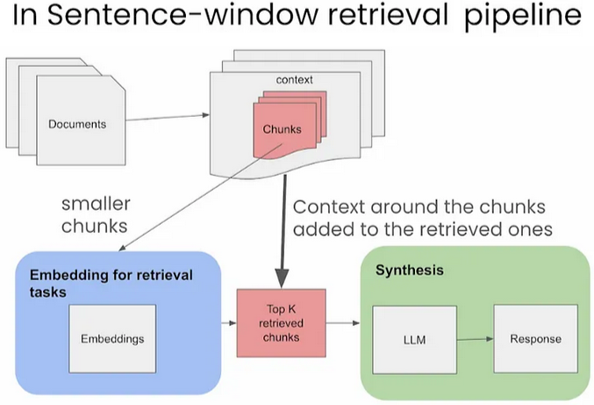

Slide 32
Sentences that are most relevant to the query
During retrieval, we retrieve the sentences that are most relevant to the query via similarity search and replace the sentence with the full surrounding context
using a static sentence-window around the context, implemented by retrieving sentences surrounding the one being originally retrieved

Slide 33
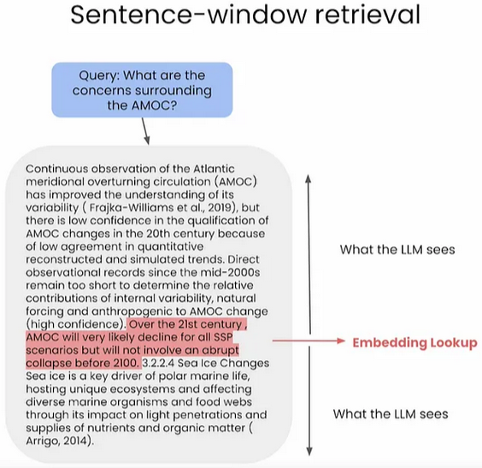

Slide 34
Advantages
Enhanced Specificity in Retrieval:
By breaking documents into smaller units, it enables more precise retrieval of segments directly relevant to a query.
Context-Rich Synthesis:
It reintroduces context around the retrieved chunks for synthesis, providing the LLM with a broader understanding to formulate responses.
Balanced Approach:
This method strikes a balance between focused retrieval and contextual richness, potentially improving response quality.

Slide 35
Disadvantages
Increased Complexity:
Managing separate processes for retrieval and synthesis adds complexity to the pipeline.
Potential Contextual Gaps:
There’s a risk of missing broader context if the surrounding information added back is not sufficiently comprehensive.

Slide 36
Retriever Ensembling and Reranking
Thought:
what if we could try a bunch of chunk sizes at once, and have a re-ranker prune the results?
This achieves two purposes:
Better (even though more costly) retrieved results by pooling results from multiple chunk sizes, assuming the re-ranker has a reasonable level of performance.
A way to benchmark different retrieval strategies against each other (w.r.t. the re-ranker).

Slide 37
The process is as follows:
Chunk up the same document in a bunch of different ways, say with chunk sizes: 128, 256, 512, and 1024.
During retrieval, we fetch relevant chunks from each retriever, thus ensembling them together for retrieval.
Use a re-ranker to rank/prune results.

Slide 38
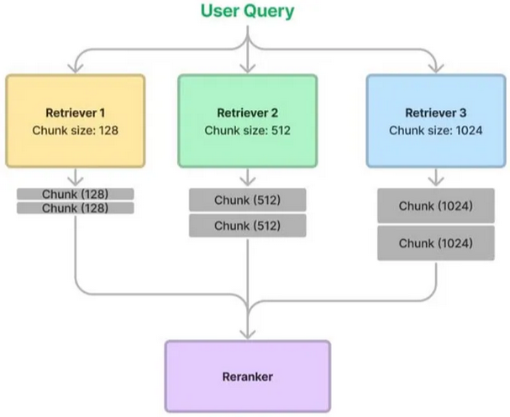

Slide 39
Cont’d
Based on evaluation results from LlamaIndex, faithfulness metrics go up slightly for the ensembled approach, indicating retrieved results are slightly more relevant.
But pairwise comparisons lead to equal preference for both approaches, making it still questionable as to whether or not ensembling is better.
https://docs.llamaindex.ai/en/stable/examples/retrievers/ensemble_retrieval
Note that the ensembling strategy can be applied for other aspects of a RAG pipeline too, beyond chunk size, such as vector vs. keyword vs. hybrid search, etc.

Slide 40
Re-ranking
Re-ranking in RAG refers to the process of evaluating and sorting the retrieved documents or information snippets based on their relevance to the given query or task.

Slide 41
There are different types of re-ranking techniques used in RAG
Lexical Re-Ranking:
This involves re-ranking based on lexical similarity between the query and the retrieved documents. Methods like BM25 or cosine similarity with TF-IDF vectors are common.
Semantic Re-Ranking:
This type of re-ranking uses semantic understanding to judge the relevance of documents. It often involves neural models like BERT or other transformer-based models to understand the context and meaning beyond mere word overlap.
Learning-to-Rank (LTR) Methods:
These involve training a model specifically for the task of ranking documents (point-wise, pair-wise, and list-wise) based on features extracted from both the query and the documents. This can include a mix of lexical, semantic, and other features.

Slide 42
Hybrid Methods:
These combine lexical and semantic approaches, possibly with other signals like user feedback or domain-specific features, to improve re-ranking.
Neural LTR methods are most commonly used at this stage since the candidate set is limited to dozens of samples.
Some common neural models used for re-ranking are:
Multi-Stage Document Ranking with BERT (monoBERT and duo BERT)
Pretrained Transformers for Text Ranking BERT and Beyond
ListT5
ListBERT

Slide 43
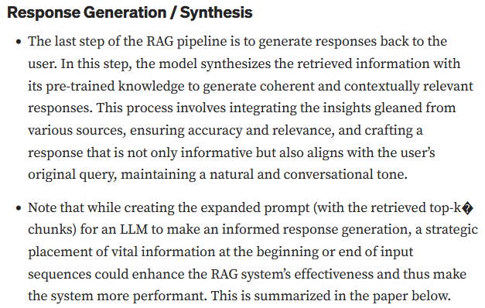

Slide 44
Lost in the Middle: How Language Models Use Long Contexts
While recent language models have the ability to take long contexts as input, relatively little is known about how well the language models use longer context.
This paper by Liu et al. from Percy Liang’s lab at Stanford, UC Berkeley, and Samaya AI analyzes language model performance on two tasks that require identifying relevant information within their input contexts: multi-document question answering and key-value retrieval. Put simply, they analyze and evaluate how LLMs use the context by identifying relevant information within it.
They tested open-source (MPT-30B-Instruct, LongChat-13B) and closed-source (OpenAI’s GPT-3.5-Turbo and Anthropic’s Claude 1.3) models. They used multi-document question-answering where the context included multiple retrieved documents and one correct answer, whose position was shuffled around. Key-value pair retrieval was carried out to analyze if longer contexts impact performance.
They find that performance is often highest when relevant information occurs at the beginning or end of the input context, and significantly degrades when models must access relevant information in the middle of long contexts. In other words, their findings basically suggest that Retrieval-Augmentation (RAG) performance suffers when the relevant information to answer a query is presented in the middle of the context window with strong biases towards the beginning and the end of it.

Slide 45
A summary of their learnings is as follows:
Best performance when the relevant information is at the beginning.
Performance decreases with an increase in context length.
Too many retrieved documents harm performance.
Improving the retrieval and prompt creation step with a ranking stage could potentially boost performance by up to 20%.
Extended-context models (GPT-3.5-Turbo vs. GPT-3.5-Turbo (16K)) are not better if the prompt fits the original context.

